Slide 1
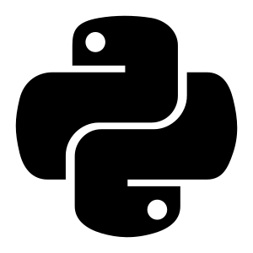
PYTHON
DAY 1 — Foundations of Python Programming

Slide 2
What is Python?
A powerful, high-level, interpreted language used for web development, automation, AI, and data science — prized for its simple, readable syntax.
Simple & Easy Syntax
Easy to Learn
Interpreted Language
Clean, English-like syntax with fewer lines of code
Straightforward rules and highly readable programs
Executes code line by line via an interpreter
High-Level Language
Platform Independent
No manual memory management required
Runs on Windows, Linux, and macOS unchanged

Slide 3

History of Python
Created by Guido van Rossum in 1989 at CWI, Netherlands — designed as a simple, readable successor to ABC.
1991
1994
2000
2008
Python 0.9.0
Python 1.0
Python 2.0
Python 3.0
First public release — classes, exceptions, core data types
Added lambda, map, filter, reduce
Garbage collection & list comprehensions
Major upgrades to syntax, performance & consistency
Today, Python is one of the world's most popular languages — powering AI, machine learning, automation, and scientific computing.

Slide 4
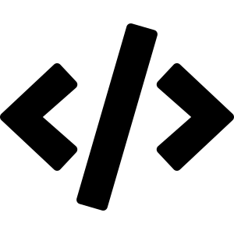
Variables & Data Types
A variable is a named memory location used to store data; its value can change during execution. The name itself is called an identifier.
Types of Variables
int
Integer values, e.g. 20
float
Decimal values, e.g. 85.5
name = "Shifa"
age = 20
marks = 85.5
str
Text, e.g. "Shifa"
bool
True / False
complex
Complex numbers

Slide 5
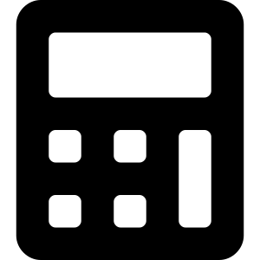
Operators in Python
Operators are symbols or keywords used to perform operations on variables and values.
Arithmetic
Comparison
Assignment
+ - * / % **
== != > <
= += -=
Mathematical calculations
Compare values → True / False
Assign values to variables
Logical
Bitwise
Identity
and or not
& | ^ ~
is is not
Combine conditional statements
Operate on binary numbers
Compare memory locations

Slide 6

Memory Management in Python
Memory management is the process of allocating, using, and freeing memory during program execution. Python handles this automatically, which makes programming easier and reduces memory-related errors.
The Heap
name = "Shifa"
All objects are stored in a memory area called the heap
Python automatically manages memory allocation for every object
Reference counting tracks how many references point to an object
When an object is no longer used, its memory is released automatically
Automatic memory management reduces programming errors and makes Python simple to use
age = 20
marks = 85.5
list1 = [1,2,3]

Slide 7
Garbage Collection in Python
Garbage collection is the process of automatically removing unused objects from memory, freeing space and improving program efficiency.
Python performs garbage collection automatically
It mainly uses reference counting to manage and track objects
When an object is no longer used, Python deletes it automatically
Garbage collection also detects and removes circular references
The gc module can be used to control garbage collection manually
Using the gc module
import gc
gc.collect()

Slide 8
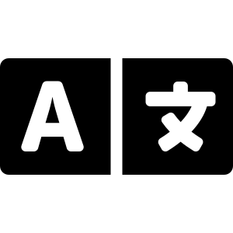
Translators & Comments
Compiler
Interpreter
Assembler
Converts the entire program to machine code at once; errors reported after full compilation; faster execution
Converts and executes code line by line; errors shown immediately; slower than a compiler
Converts assembly language into machine language; used for low-level programming
Comments
Comments explain code and are ignored by the interpreter during execution — improving readability and maintenance.
Single-line Comment
Multi-line Comment
# This is a single-line comment
""" This is a multi-line comment """

Slide 9

Conditional & Control Statements
Conditional Statements
Control Statements
if
Executes a block only if the condition is true
break
Stops a loop immediately when triggered
if-else
Runs one block if true, another if false
continue
Skips the current iteration, moves to next
if-elif-else
Checks multiple conditions in sequence
Nested if
An if statement placed inside another if

Slide 10

Loops in Python — the for Loop
Loops execute a block of code repeatedly, reducing repetition and making programs efficient. Python mainly provides two types of loops: for loop and while loop.
Example
for Loop
for i in range(1, 6):
print(i)
A for loop is used to iterate over a sequence such as a list, tuple, string, or range
The loop body runs once for every item in the sequence
Commonly combined with range() to repeat an action a fixed number of times
Iterating over a list
fruits = ["apple", "banana", "cherry"]
for fruit in fruits:
print(fruit)

Slide 11
The while Loop
A while loop executes a block of code repeatedly as long as its condition remains true — useful when the number of repetitions isn't known in advance.
Example
i = 1
while i <= 5:
print(i)
i += 1
The condition is checked before every iteration
The loop continues until the condition becomes false
The loop variable must be updated inside the loop, or it may run forever
for Loop vs while Loop
Use a for loop when iterating over a known sequence (list, tuple, string, range). Use a while loop when repetition depends on a condition rather than a fixed sequence.

Slide 12
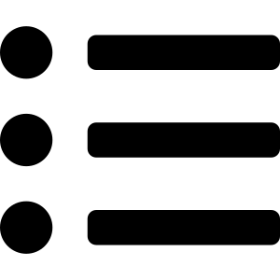
Lists & Strings
List
String
list1 = [1, 2, 3, 4]
name = "Python"
Ordered, mutable, allows duplicates — created with [ ]
Immutable sequence of characters — supports indexing & slicing
Common List Operations
Adding Elements
Removing Elements
list1 = [1, 2, 3]
list1.append(4)
print(list1)
list1 = [1, 2, 3]
list1.remove(2)
print(list1)

Slide 13
Tuples in Python
A tuple is a collection data type used to store multiple items in a single variable. Tuples are created using parentheses ( ).
Key Characteristics
tuple1 = (1, 2, 3)
print(tuple1)
Ordered collection
Immutable — cannot be changed after creation
Allows duplicate elements
Can store different data types
Common Tuple Operations
Length
Concatenation
Repetition
tuple1 = (1, 2, 3)
print(len(tuple1))
t1 = (1, 2)
t2 = (3, 4)
print(t1 + t2)
print((1, 2) * 2)

